Slide 1

AGENTIC PRIVACY CONTROL SYSTEM
DEPARTMENT OF COMPUTER SCIENCE
JAWAHARLAL NEHRU TECHNOLOGICAL UNIVERSITY HYDERABAD UNIVERSITY COLLEGE OF ENGINEERING SCIENCE AND TECHNOLOGY
Kukatpally, Hyderabad
DISSERTATION WORK REVIEW – 1
AUGUST-2026
GUIDE:
Dr. I. Lakshmi Manikyamba
Professor, Department of CSE
JNTUH UCESTH
PRESENTED BY:
Billa Anshu
22011P0506
CSE IDP 5th YEAR

Slide 2
ABSTRACT
Users encounter consent banners on nearly every website but rarely have time to read lengthy privacy policies, leading to reflexive "Accept All" clicks that undermine genuine consent. Existing tools address this only partially: rule-based tools like Consent-O-Matic fail on unknown consent platforms, while policy analyzers like Polisis classify text but never act on the user's behalf.
This system proposes a hybrid agentic system combining rule-based template matching for known CMPs with LLM-based generalization for unrecognized banners. The system supports three privacy levels, logs every decision with its triggering rule, and escalates uncertain cases to the user—providing a practical, transparent alternative to existing partial solutions.
2

Slide 3
INTRODUCTION
Consent banners create decision fatigue and interrupt user experience, yet privacy choices carry significant data consequences
This work designs an intelligent assistant that automates consent decisions based on user-defined privacy preferences
System ensures transparency via logging and maintains user agency through selective escalation of uncertain cases
3

Slide 4
PROBLEM STATEMENT
To build a hybrid agentic system that automatically manages website consent decisions by combining rule-based template matching for known consent platforms with LLM-based policy reading for unrecognized banners.
4

Slide 5
OBJECTIVES
Design a privacy-level abstraction (Strict / Balanced / Permissive )
Build a hybrid decision engine: rule-based fast path + LLM-based fallback
Attach a confidence score to every LLM-derived decision; escalate low-confidence / high-risk cases
Log every decision with the specific rule or policy clause that produced it
Evaluate decision accuracy and coverage across known and unknown consent platforms
5

Slide 6
LITERATURE REVIEW
SYSTEM | APPROACH | LIMITATIONS
Privacy Guardian Agent (2026) (Base Paper) | Position paper proposing an LLM agent with escalation | Conceptual only — no implementation or evaluation
Polisis (2018) | Deep-learning classifier mapping policy text to a data-practice taxonomy | Classifies policy text but does not act on the classification
PriBots (2016) | Conversational chatbot over Polisis classifications | Answers user questions; does not automate consent decisions
Consent-O-Matic (2020) | Rule-based templates auto-answering banners for ~150–200+ cataloged CMPs | Purely rule-based; fails outside its template catalogue
AudAgent (2025) | Formalizes privacy policies for runtime auditing of AI agents | Targets AI-agent auditing, not consumer consent management
6

Slide 7
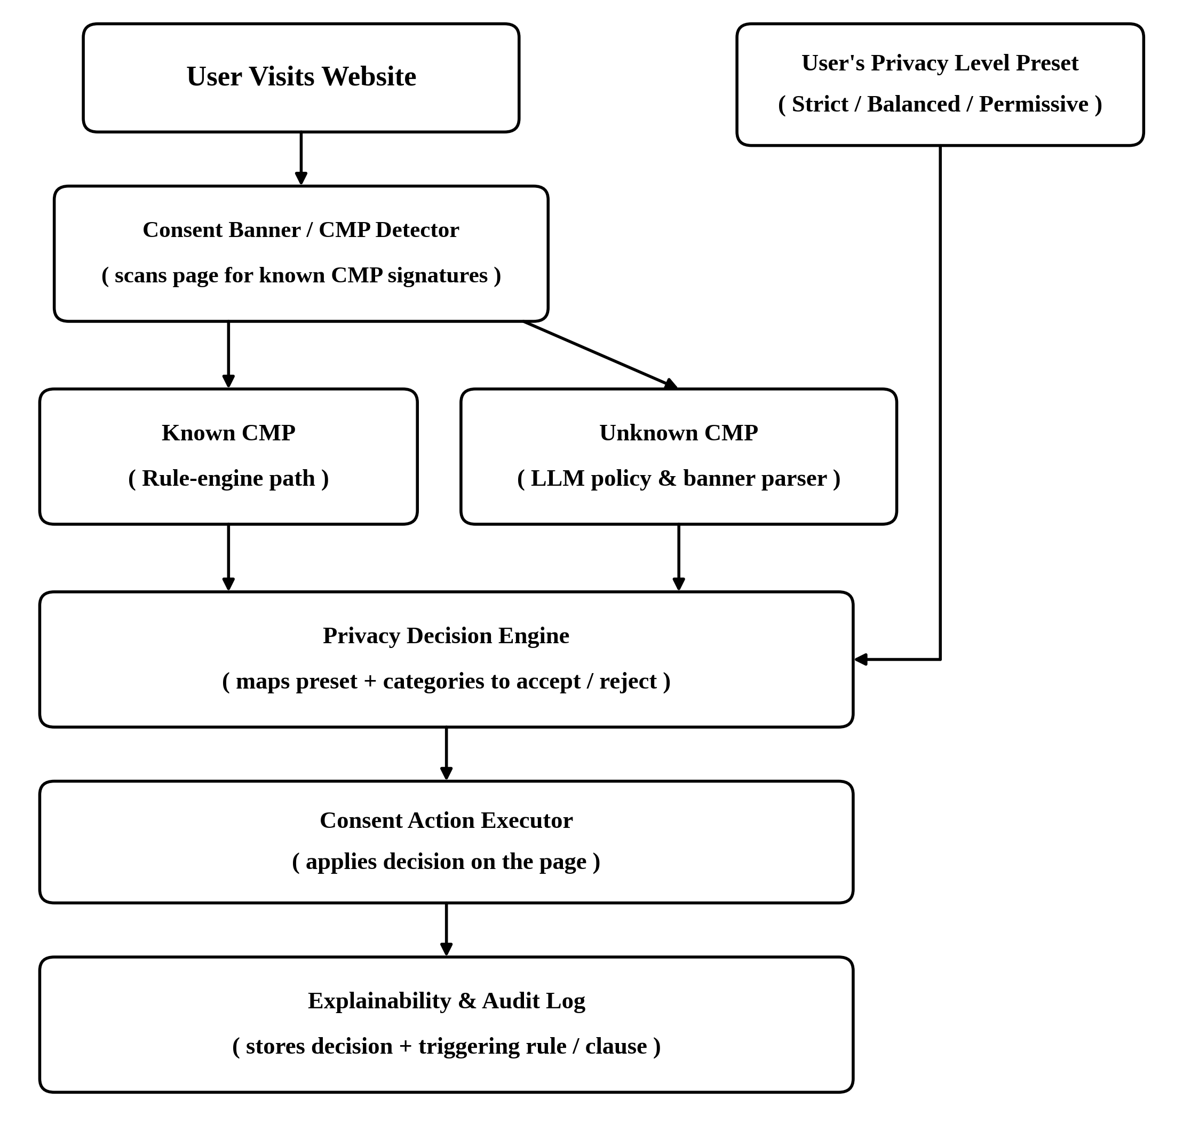
PROPOSED WORK
7

Slide 8
TECHNOLOGY STACK
Extension framework: Chrome / Firefox WebExtensions API
Languages: JavaScript (extension), Python (backend)
Agent orchestration: LangGraph , LangChain
LLM / RAG: GPT-4, Sentence Transformers, RAG
Vector DB: ChromaDB
Rule engine: Consent-O-Matic rules, IAB TCF v2.0
Frontend: React + Bootstrap
Storage: local storage for explainability log & preferences
8

Slide 9
DATASET
A curated set of real websites split into known-CMP sites (OneTrust, Cookiebot, Didomi) and unknown/custom-banner sites, across e-commerce, news, and SaaS categories
Ground truth is created manually — under a fixed "Strict" preset, the actual banner/policy is read and the correct accept/reject decision is recorded per category (Analytics, Functional, Advertising, Third-Party Sharing)
9

Slide 10
EVALUATION
Decision Accuracy: system's per-category decisions compared to manual ground truth, reported separately for known-CMP vs. unknown-CMP subsets
Escalation Correctness: system's escalation flags checked against a separate "should this have been escalated" label, prioritizing recall since a missed escalation means a wrong decision applied silently
10

Slide 11
CONCLUSION
The proposed hybrid agentic privacy control system combines the reliability of rule-based automation with the generality of LLM-based policy reading, applying a user-defined privacy level consistently across known and unknown consent platforms. Confidence-based escalation and an explainability log keep the agent's behavior transparent and auditable rather than a silent black box. Once implemented, the system will be evaluated on decision accuracy and escalation correctness — positioning it as a practical, working alternative to both purely rule-based and purely conceptual prior approaches.
11

Slide 12
REFERENCES
[1] H. Harkous, K. Fawaz, R. Lebret, F. Schaub, K. G. Shin, and K. Aberer, "Polisis: Automated Analysis and Presentation of Privacy Policies Using Deep Learning," in Proc. USENIX Security Symp., 2018, pp. 531–548.
[2] H. Harkous et al., "PriBots: Conversational Privacy with Chatbots," in Workshop on the Future of Privacy Indicators, SOUPS, 2016.
[3] CAVI, Aarhus University, "Consent-O-Matic: Automatically Answering Consent Pop-ups Using Adversarial Interoperability," in Proc. ACM CHI Conf. Hum. Factors Comput. Syst., 2022.
[4] V. Freiberger, "The Privacy Guardian Agent: Towards Trustworthy AI Privacy Agents," arXiv preprint arXiv:2604.21455, 2026.
[5] Y. Zheng et al., "AudAgent: Automated Auditing of Privacy Policy Compliance in AI Agents," arXiv preprint arXiv:2511.07441, 2025.
[6] IAB Europe, "Transparency & Consent Framework (TCF) v2.2 Specification," iabeurope.eu
[7] T. Ma, T. Tang, Y. Lyu, H. Yin, Y. Ong, and I. Tsang, "PrivAgentFlow: Agentic Workflow for Distributed Privacy Control in Web Agents," in NeurIPS Workshop Soc. Responsible Trustworthy Found. Models, 2025.
[8] "Towards Smart and User-Centric Privacy-Aware Consent Systems," in Proc. IEEE Int. Conf. Consum. Electron. (ICCE), Las Vegas, NV, USA, Jan. 2026.
[9] Y. Cheng, H. Ye, H. Li, J. Sun, and Y. Chen, "PrivAct: Internalizing Contextual Privacy Preservation via Multi-Agent Preference Training," in Proc. Int. Conf. Mach. Learn. (ICML), 2026.
[10] H. Guo, "ConsentDiff at Scale: Longitudinal Audits of Web Privacy Policy Changes and UI Frictions," arXiv preprint arXiv:2512.04316, 2025

Slide 13
THANK YOU
13

